Slide 1
IS 466 Decision Support Systems
Lecture 4
Forecasting
The slides content is derived and adopted from many references

Slide 2
What is Forecasting?
Forecasting is the process of predicting the future.
Forecasting is an integral part of almost all business enterprises.
Examples
  Manufacturing firms forecast demand for their product, to schedule manpower and raw material allocation.
  Service organizations forecast customer arrival patterns to maintain adequate customer service.
  Monetary security analysts forecast revenues, profits, and debt ratios, to make investment recommendations.
  Firms consider economic forecasts of indicators (housing starts, changes in gross national profit) before deciding on capital investments.

Slide 3
Introduction
Good forecasts can lead to
  Reduced inventory costs.
  Lower overall personnel costs.
  Increased customer satisfaction.
The forecasting process can be based on:
  Educated guess.
  Expert opinions.
  Past history of data values, known as a time series.

Slide 4
Types of Forecasts by Time Horizon
Short-range forecast
  Usually 3 months – 1 year
  Job scheduling, worker assignments
Medium-range forecast
  3 months to 3 years
  Sales & production planning, budgeting
Long-range forecast
  3⁺ years
  New product planning, facility location
Notes:
At this point, it may be useful to point out the “time horizons” considered by different industries. For example, some colleges and universities look 30 to fifty years ahead, industries engaged in long distance transportation (steam ship, railroad) or provision of basic power (electrical and gas utilities, etc.) also look far ahead (20 to 100 years). Ask them to give examples of industries having much shorter long-range horizons.

Slide 5
Forecasting Approaches
Qualitative Methods
Quantitative Methods
Used when situation is vague & little data exist
  New products
  New technology
Involves intuition, experience
  e.g., forecasting sales on Internet
Used when situation is ‘stable’ & historical data exist
  Existing products
  Current technology
Involves mathematical techniques
  e.g., forecasting sales of color televisions
Notes:
This slide distinguishes between Quantitative and Qualitative forecasting. If you accept the argument that the future is one of perpetual, and perhaps significant change, you may wish to ask students to consider whether quantitative forecasting will ever be sufficient in the future - or will we always need to employ qualitative forecasting also. (Consider Example Corporation’s ‘jury of executive opinion.’)

Slide 6
Overview of Qualitative Methods
Jury of executive opinion
  Pool opinions of high-level executives, sometimes augment by statistical models
Delphi method
  Panel of experts, queried iteratively
Sales force composite
  Estimates from individual salespersons are reviewed for reasonableness, then aggregated
Consumer Market Survey
  Ask the customer
Notes:
This slide outlines several qualitative methods of forecasting. Ask students to give examples of occasions when each might be appropriate.
The next several slides elaborate on these qualitative methods.

Slide 7
Overview of Quantitative Approaches
A time series is an uninterrupted set of data observations that have been ordered in equally spaced intervals (units of time).
Associative (causal) forecasting is based on identification of variables (factors) that can predict values of the variable in question.
Time-series Models
  Naïve approach
  Moving averages
  Exponential smoothing
  Trend projection
Associative Models
  Linear regression
Notes:
A point you may wish to make here is that only in the case of linear regression are we assuming that we know “why” something happened. General time-series models are based exclusively on “what” happened in the past; not at all on “why.” Does operating in a time of drastic change imply limitations on our ability to use time series models?

Slide 8
What is a Time Series?
A time series is a sequence of evenly spaced events.
Time-series forecasts predict the future based solely on the past values of the variable, and other variables are ignored.
Set of evenly spaced numerical data
  Obtained by observing response variable at regular time periods
Forecast based only on past values
  Assumes that factors influencing past and present will continue influence in future
Example
  Year: 1998 1999 2000 2001 2002
  Sales: 78.7 63.5 89.7 93.2 92.1
Notes:
This and subsequent slide frame a discussion on time series - and introduce the various components.

Slide 9
Components of a Time-Series
A time series typically has four components:
  Trend (T) is the gradual upward or downward movement of the data over time.
  Seasonality (S) is a pattern of demand fluctuations above or below the trend line that repeats at regular intervals.
  Cycles (C) are patterns in annual data that occur every several years.
  Random variations (R) are “blips” in the data caused by chance or unusual situations, and follow no discernible pattern.
Notes:
Long-term trend
A time series may be stationary or exhibit trend over time.
Long-term trend is typically modeled as a linear, quadratic or exponential function.
Seasonal variation
When a repetitive pattern is observed over some time horizon, the series is said to have seasonal behavior.
Seasonal effects are usually associated with calendar or climatic changes.
Seasonal variation is frequently tied to yearly cycles.
Cyclical variation
An upturn or downturn not tied to seasonal variation.
Usually results from changes in economic conditions.
Random effects

Slide 10
Stationary Forecasting Models
In a stationary model the mean value of the time series is assumed to be constant.
If a time series does not have a trend, seasonality or cyclical components it will be stationary.
The general form of such a model is
  Where:
    y_{t} = the value of the time series at time period t.
    β₀ = the unchanged mean value of the time series.
    ε_{t} = a random error term at time period t.
The values of ε_{t} are assumed to be independent
The values of ε_{t} are assumed to have a mean of 0.
y_{t} = β₀ + ε_{t}

Slide 11
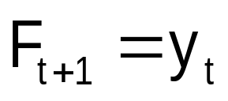
The Last Period Method
  The forecast for the next period is the last observed value.
e.g., if May sales were 50 then June sales will be 50
• Sometimes cost effective & efficient
– At least it provides a starting point which more
sophisticated models that follow can be compared

Slide 12
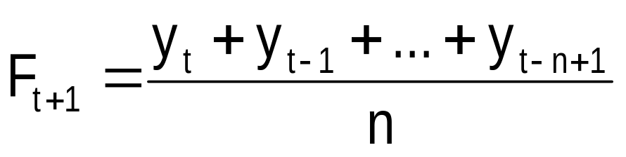

(Weighted)Moving Average Methods
The forecast is the average of the last n observations of the time series.
The weighted moving average method
  More recent values of the time series get larger weights than past values when performing the forecast.
= w₁y_{t} + w₂y_{t-1} +w₃y_{t-2} + …+ w_{n}y_{t-n+1}
w₁ ≥ w₂ ≥ … ≥ w_{n}
Σw_{i} = 1

Slide 13
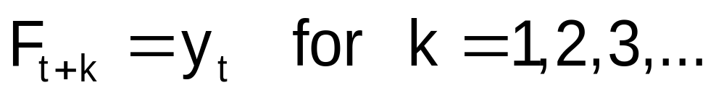
Moving Average Methods
Forecasts for Future Time Periods
  The forecast for time period t+ 1 is the forecast for all future time periods:
  This forecast is revised only when new data becomes available.

Slide 14
Example (1/7)
Galaxy Industries is interested in forecasting weekly demand for its YoHo brand yo-yos.
The yo-yo is a mature product. This year demand pattern is expected to repeat next year.
To forecast next year demand, the past 52 weeks demand records were collected.

Slide 15
Example (2/7)
Three forecasting methods were suggested:
  Last period technique - suggested by Amy Chang.
  Four-period moving average - suggested by Bob Gunther.
  Four-period weighted moving average - suggested by Carlos Gonzalez.
Management wants to determine:
  If a stationary model can be used.
  What forecast will be obtained using each method?

Slide 16
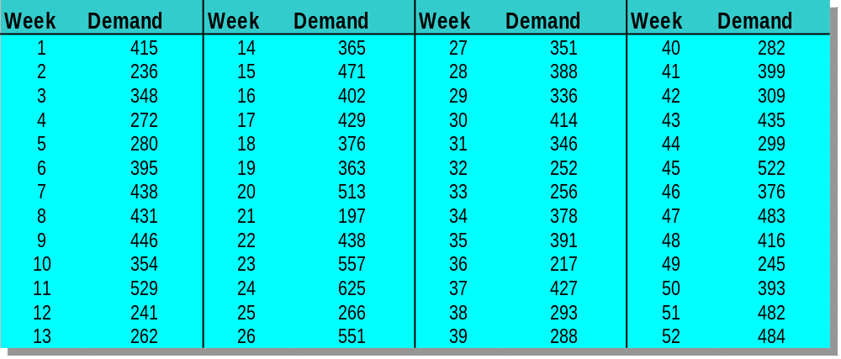
Example (3/7)
Collection of demand record

Slide 17
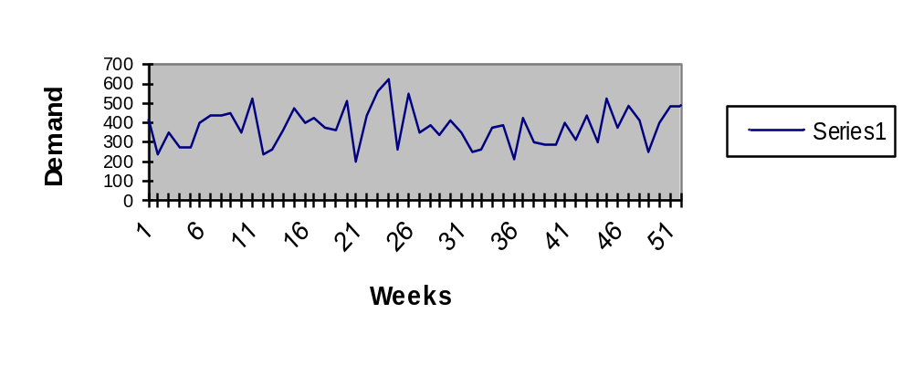
Example (4/7)
Construct the time series plot
Neither seasonality nor cyclical effects are observed. So, a stationary model may be appropriate

Slide 18



Example (5/7)
Forecast for Week 53
Last period technique (Amy’s Forecast)
  Four-period moving average (Bob’s forecast)
  Four period weighted moving average (Carlo’s forecast)
₅₃ = y₅₂
= 484 boxes.
₅₃ = (y₅₂ + y₅₁ + y₅₀ + y₄₉) /4 = (484+482+393+245) / 4 = 401 boxes.
₅₃ =0.4y₅₂ + 0.3y₅₁ + 0.2y ₅₀ + 0.1y₄₉ =
0.4(484) + 0.3(482) + 0.2(393) + 0.1(245) = 441.3 boxes.

Slide 19
Example (6/7)
Forecast for Weeks 54 and 55
Since the time series is stationary, the forecasts for weeks 54 and 55 remain as the forecast for week 53.
These forecasts will be revised pending observation of the actual demand in week 53.

Slide 20
Disadvantages of
Moving Average Methods
Weighted Moving Average can put greater weight on the more recent observations, it uses only last n periods data values and ignores the history of the time series prior to that time.
Increasing n makes forecast less sensitive to changes
Do not forecast trend well
Require much historical data
Solution: Exponential Smoothing Method
Notes:
These points should have been brought out in the example, but can be summarized here.

Slide 21
The Exponential Smoothing Technique
This technique is used to forecast stationary time series.
All the previous values of historical data affect the forecast.
For each period create a smoothed value L_{t} of the time series, that represents all the information known by t.
The smoothed value L_{t} is the weighted average of
  The current period’s actual value (with weight of α).
  The forecast value for the current period (with weight of 1-α).
The smoothed value L_{t} becomes the forecast for period t+1.

Slide 22
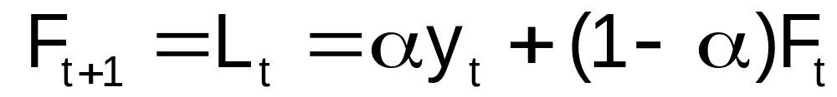
The Exponential Smoothing Technique
Define:
F_{t+1} = the forecast value for time t+1
y_{t} = the value of the time series at time t
α = smoothing constant
An initial “forecast” is needed to start the process.

Slide 23


The Exponential Smoothing Technique –
Generating an initial forecast
  Approach 1:
  Continue from t=3 with the recursive formula.
  Approach 2:
      Average the initial “ n ” values of the time series.
      Use this average as the forecast for period n + 1
      Begin using exponential smoothing from that time period
      onward
      and so on.

Slide 24
The Exponential Smoothing Technique –
Future Forecasts
Since this technique deals with stationary time series, the forecasts for future periods does not change.
Assume N is the number of periods for which data are available. Then
  F_{N+1} = αy_{N} + (1 – α)F_{N},
  F_{N+k} = F_{N+1}, for k = 2, 3, …

Slide 25
YOHO BRAND YO - YOs
The Exponential Smoothing Technique
An exponential smoothing forecast is suggested, with α = 0.1.
An Initial Forecast is created at t=2 by F₂ = y₁ = 415.
The recursive formula is used from period 3 onward:
F₃ = .1y₂ + .9F₂ = .1(236) + .9(415) = 397.10
F₄ = .1y₃ + .9F₃ = .1(348) + .9(397.10) = 392.19
and so on, until period 53 is reached (N+1 = 52+1 = 53).
F₅₃ = .1y₅₂ + .9F₅₂ = .1(484) + .9(382.32) = 392.49
F₅₄ = F₅₅ = 392.49 ( = F₅₂)

Slide 26
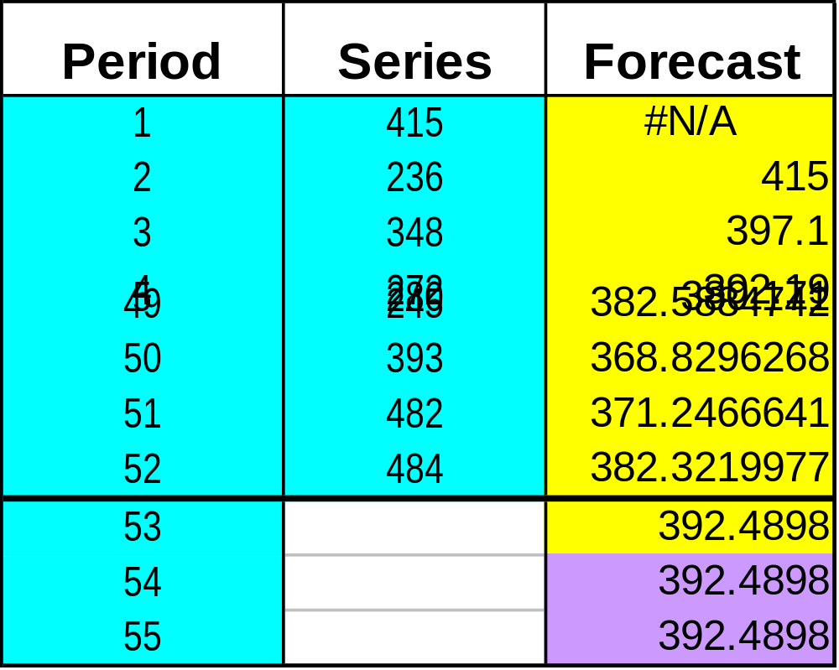
YOHO BRAND YO - YOs
The Exponential Smoothing Technique (Excel)

Slide 27
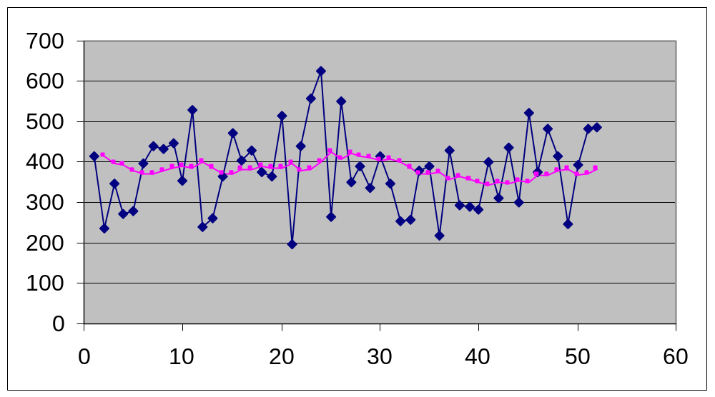
YOHO BRAND YO - YOs
The Exponential Smoothing Technique (Excel)
Notice the amount of smoothing
Included in the smoothed series

Slide 28
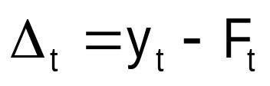
Performance Measures
Generally, to evaluate each forecasting method:
  Select an evaluation measure.
  Calculate the value of the evaluation measure using the forecast error equation
  Select the forecast with the smallest value of the evaluation measure.

Slide 29
Performance Measures –
Sample Example
Find the forecasts and the errors for each forecasting technique applied to the following stationary time series.
Time 1 2 3 4 5 6
Time series: 100 110 90 80 105 115
3-Period Moving average: 100 93.33 91.6
Error for the 3-Period MA: - 20 11.67 23.4
3-Period Weighted MA(.5, .3, .2) 98 89 85.5
Error for the 3-Period WMA - 18 16 29.5

Slide 30
Performance Measures
Σ(Δ _{t})²
n
Σ |Δ_{t}|
n
y_{t}
MSE =
n
MAPE =
|Δ _{t}|
n
Σ
MAD =
LAD = max
|Δ _{t}|

Slide 31
Performance Measures –
MSE for the Sample Example
MSE for the moving average technique:
Σ(Δ_{t})²
n
(-20)²+(11.67)²+(23.4)²
3
MSE = =
= 361.24
Divide by 3, not by 6 periods.
Period 1, 2, 3 do not have a forecast
MSE for the weighted moving average technique:
Σ(Δ_{t})²
n
(-18)² + (16)² + (29.5)²
3
MSE = =
= 483.4

Slide 32
Performance Measures –
MAD for the Sample Example
MAD for the moving average technique:
|Δ _{t}|
n
Σ
MAD = =
|-20| + |11.67| + |23.4|
3
= 18.35
MAD for the weighted moving average technique:
|Δ _{t}|
n
Σ
MAD = =
|-18| + |116| + |29.5|
3
= 21.17

Slide 33
Performance Measures –
MAPE for the Sample Example
MAPE for the moving average technique:
|Δ _{t}|
n
Σ
MAPE= =
|-20|/80 + |11.67|/105+ |23.4|/115
3
= .188
MAPE for the weighted moving average technique:
|Δ _{t}|
n
Σ
MAPE= =
|-18|/80 + |16|/105 + |29.5|/115
3
= .211

Slide 34
Performance Measures –
LAD for the Sample Example
LAD for the weighted moving average technique:
|Δ _{t}|
LAD= max =
max {|-18|, |16|, |29.5|}
= 29.5
LAD for the moving average technique:
|Δ _{t}|
LAD= max =
|-20|, |11.67|, |23.4|
= 23.4

Slide 35
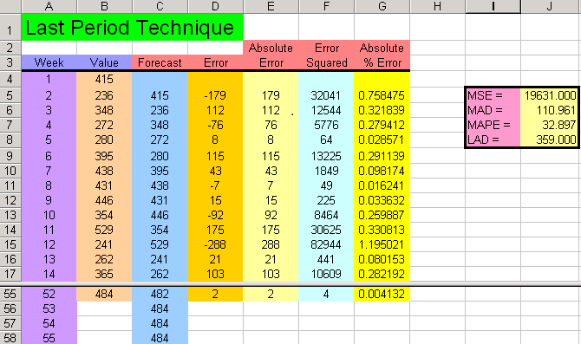
Performance Measures –
YOHO BRAND YO - YOs
=B4
Drag to Cell C56
=E5/B5
=D5^2
=ABS(D5)
Highlight Cells D5:G5 and Drag to Cells D55:G55
=B5-C5

Slide 36
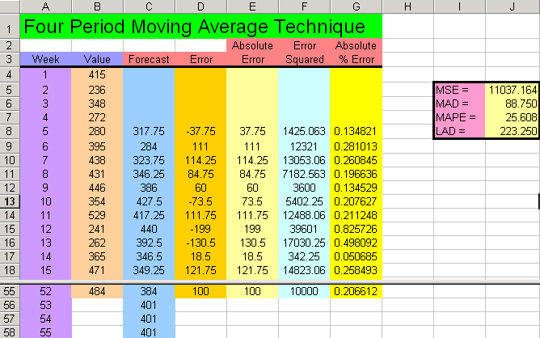
Performance Measures –
YOHO BRAND YO - YOs
=AVERAGE(B4:B7)
Drag to Cell C56
Forecast begins at period 5.
=E8/B8
=D8^2
=ABS(D8)
Highlight Cells D8:G8 and Drag to Cells D55:G55
=B8-C8
=C56
Drag to C58

